Slide 1
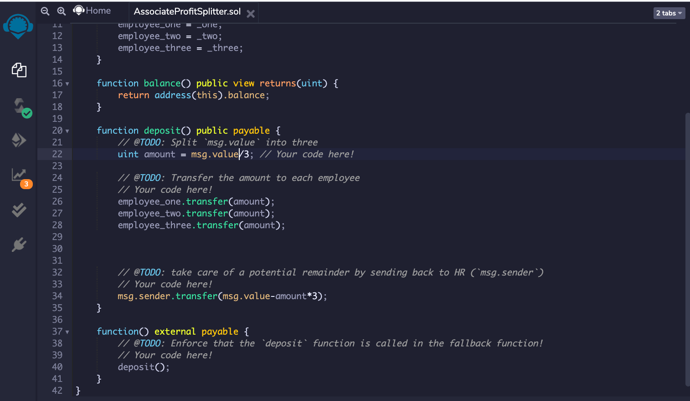
Create the first contract

Slide 2
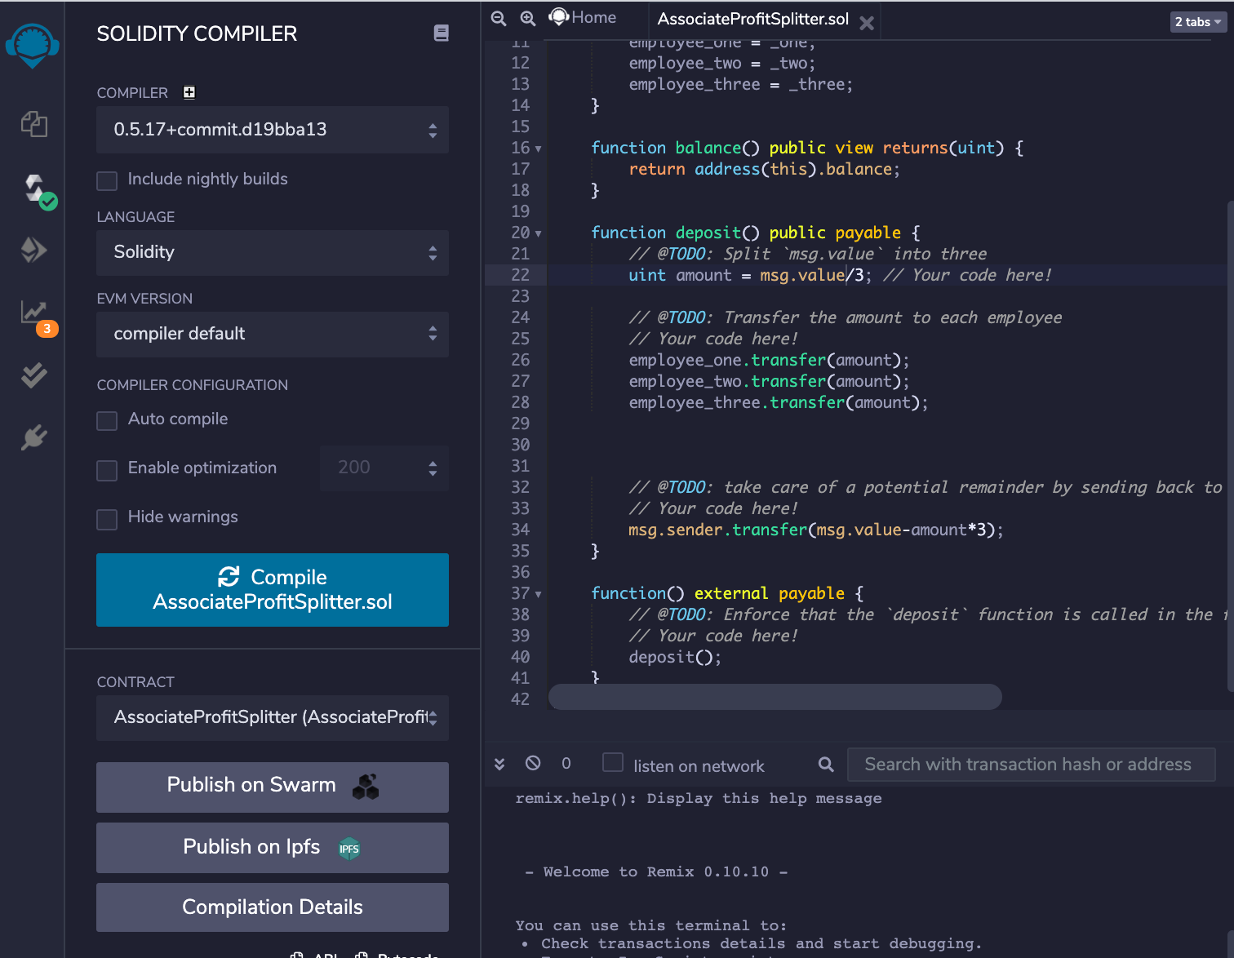
Compiling first contract

Slide 3
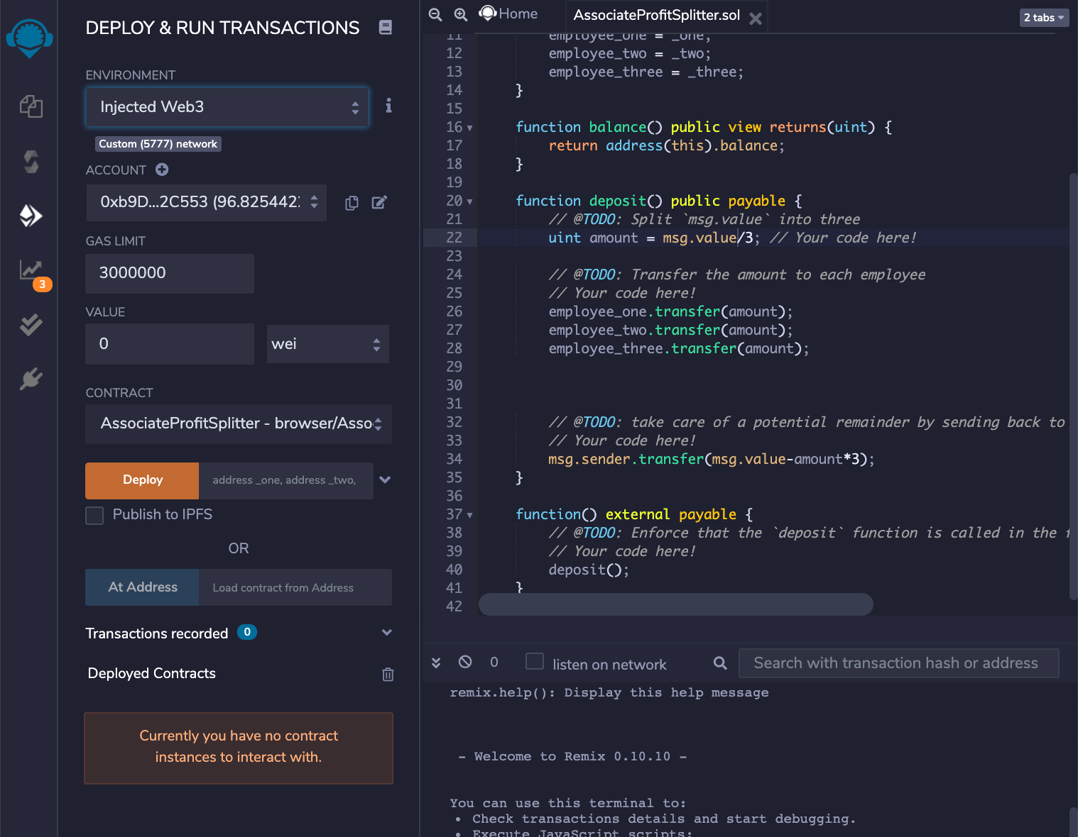
Deploy the first contract

Slide 4
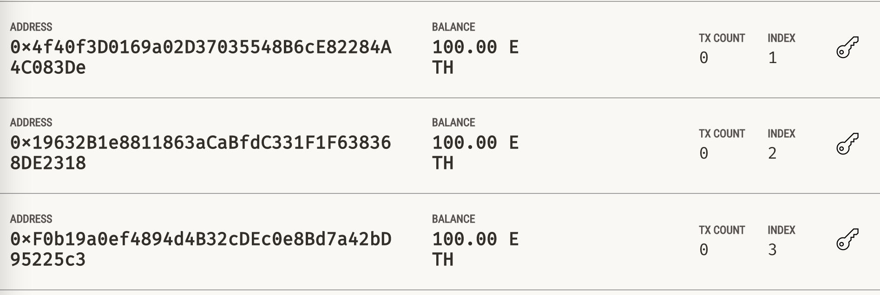
Acount Addresses balance before the deposit

Slide 5
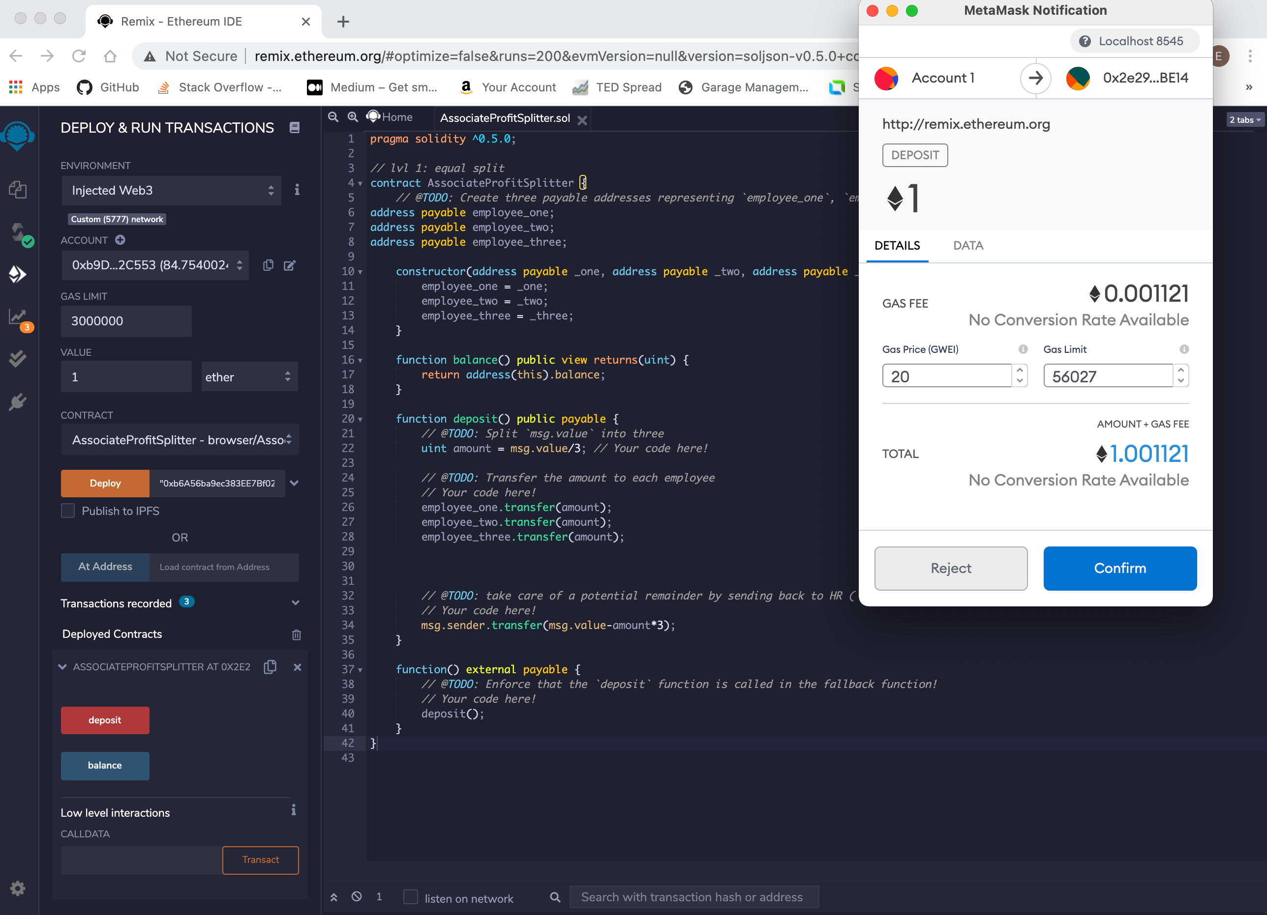
Deposit test

Slide 6
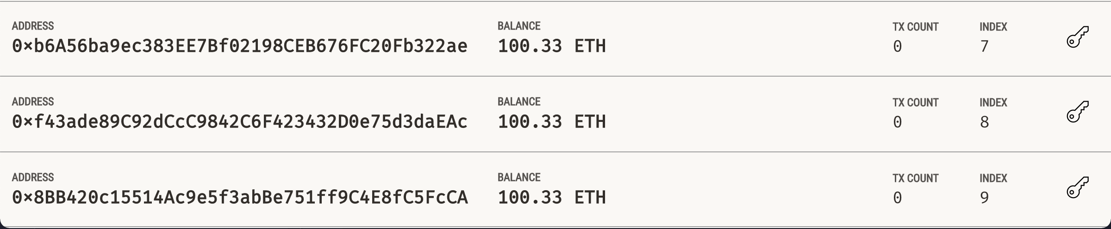
Accounts balance after the deposit

Slide 7
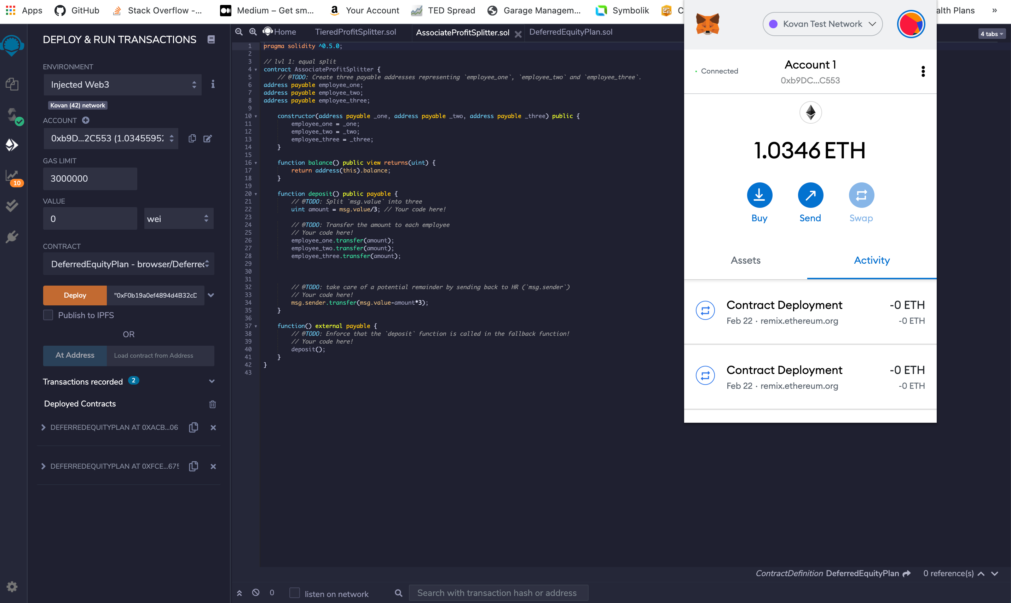
Deploy the first contract in live Tesnet

Slide 8
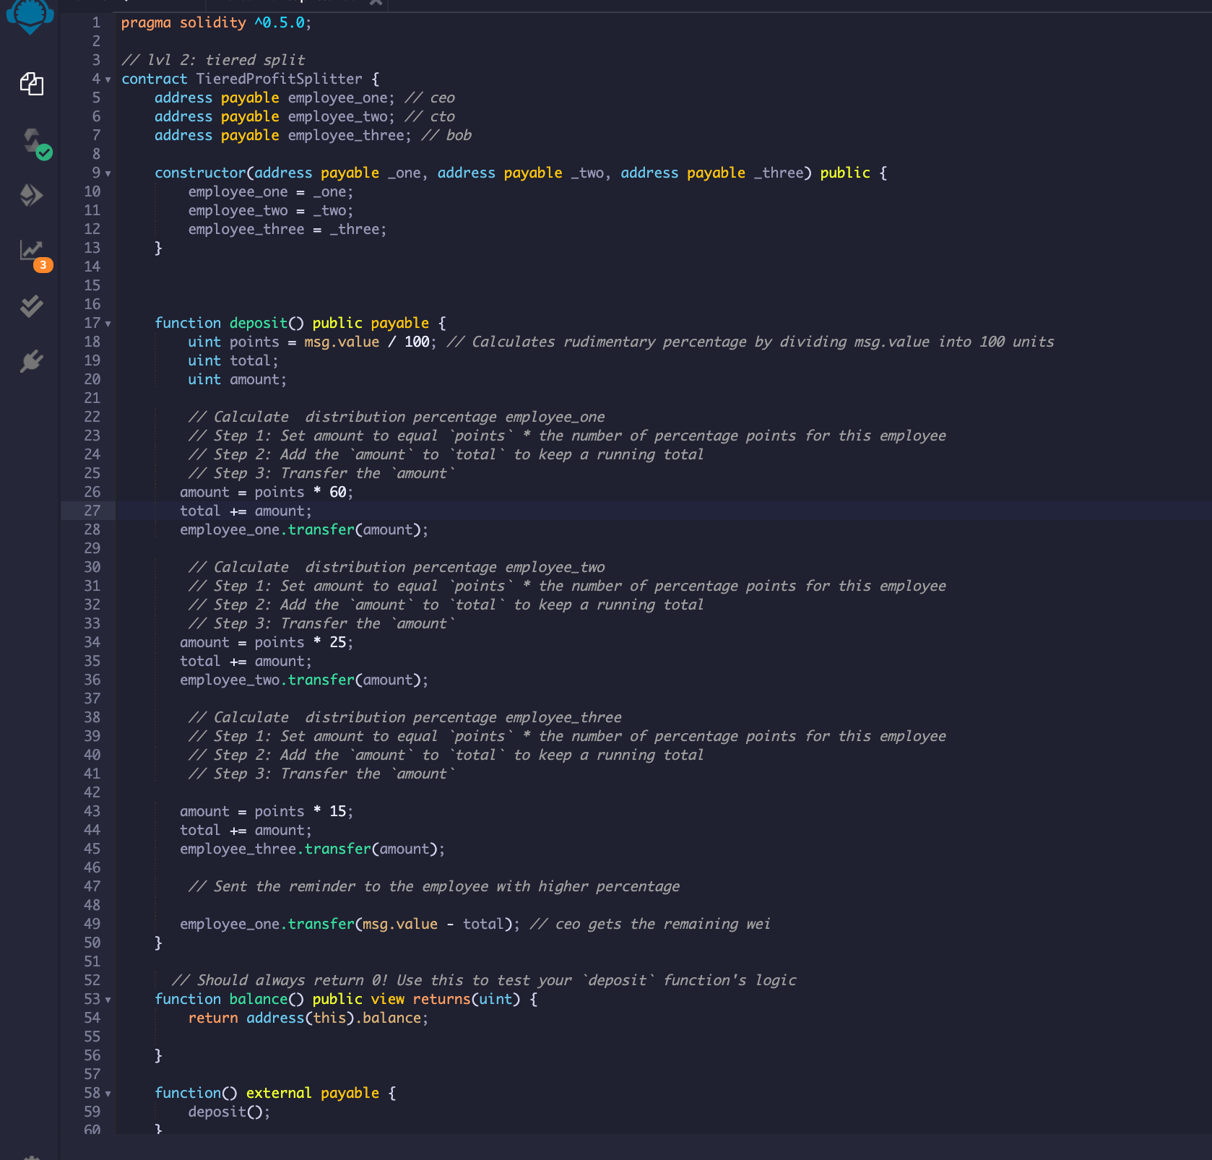
Create second contract

Slide 9
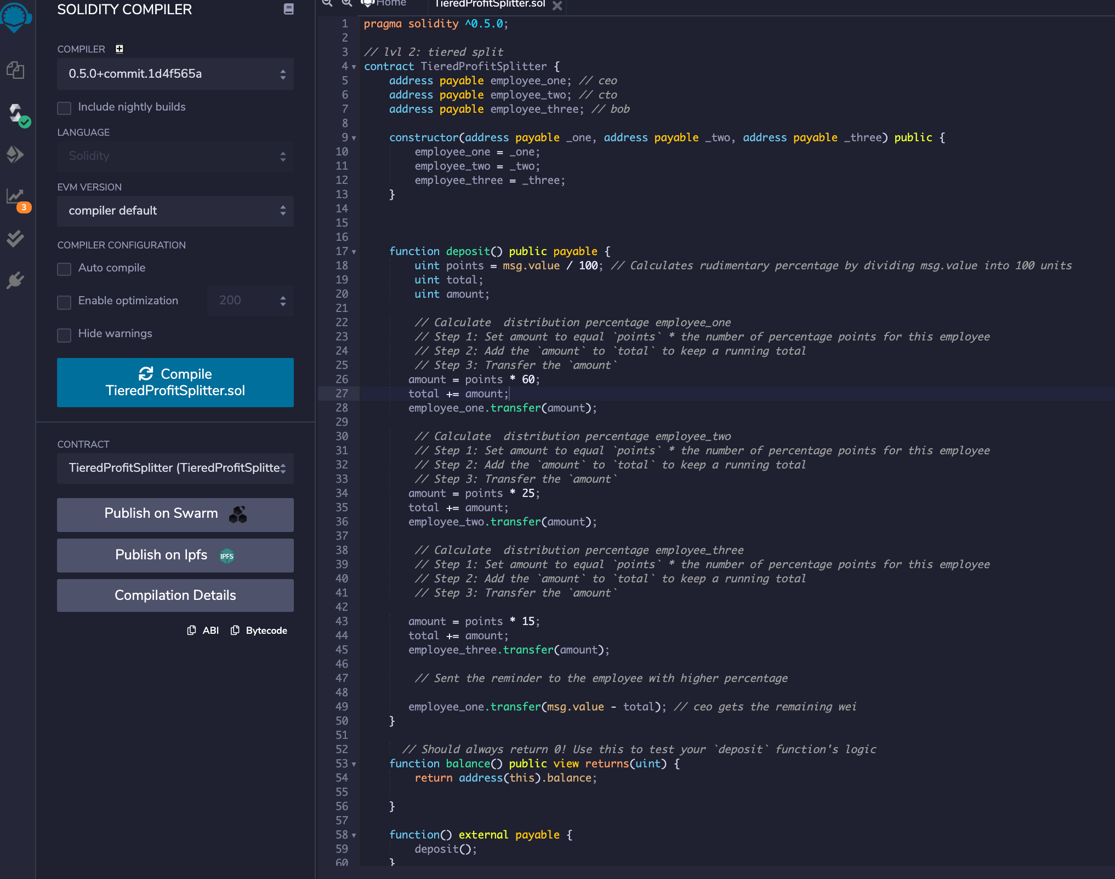
Compile second contract

Slide 10
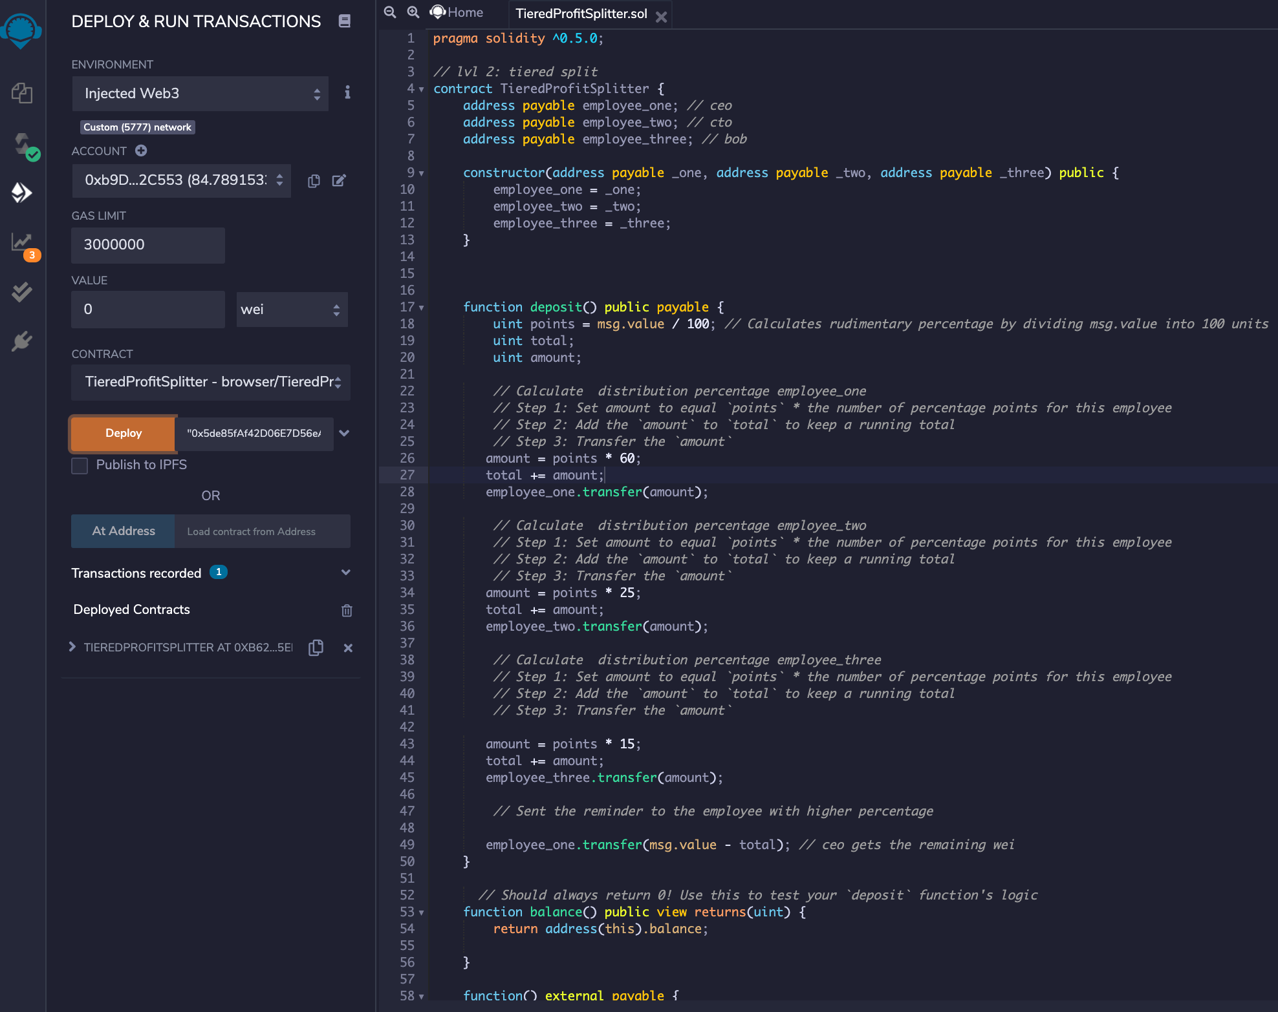
Deploy Second contract

Slide 11
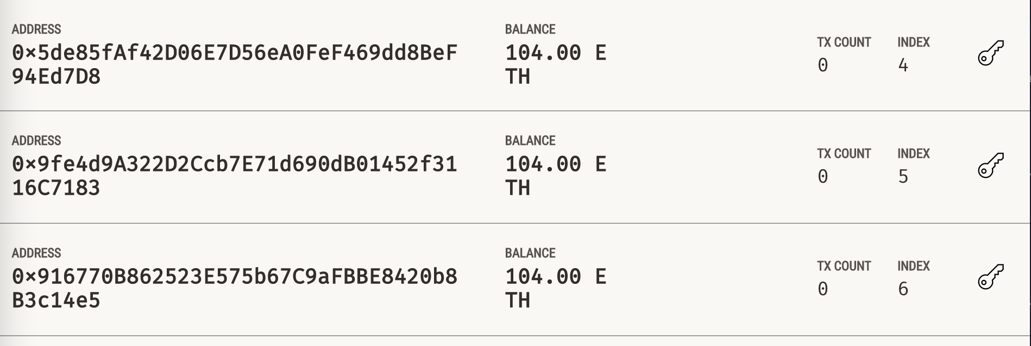
Account Adresses before the deposit

Slide 12
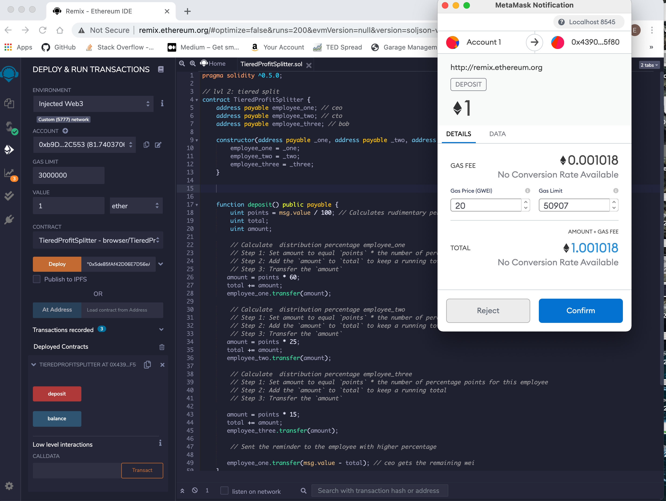
Test second contract

Slide 13
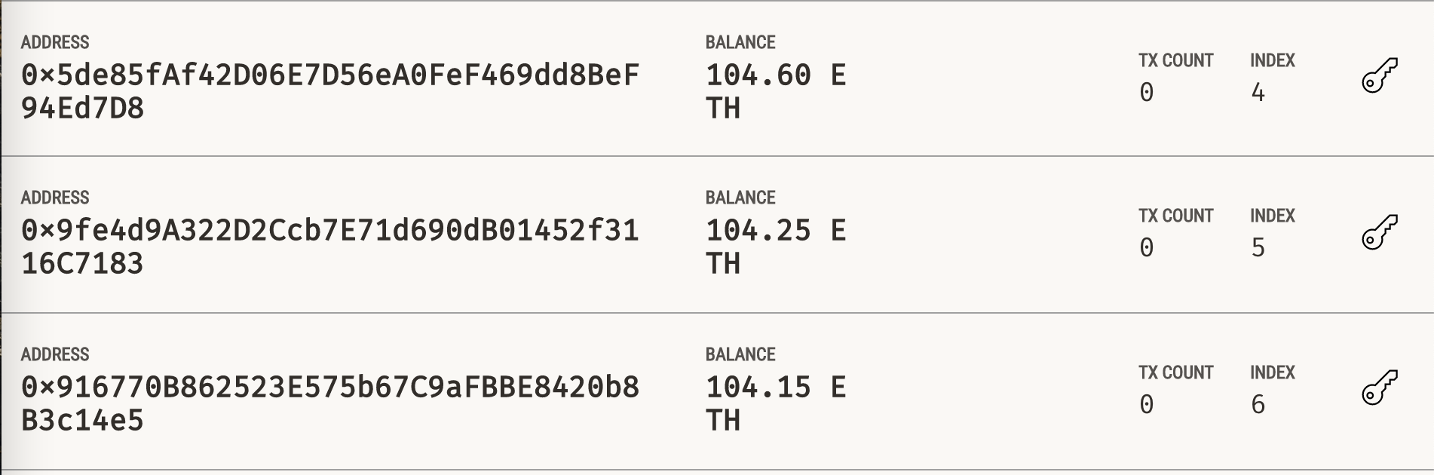
Account addresses after the deposit

Slide 14
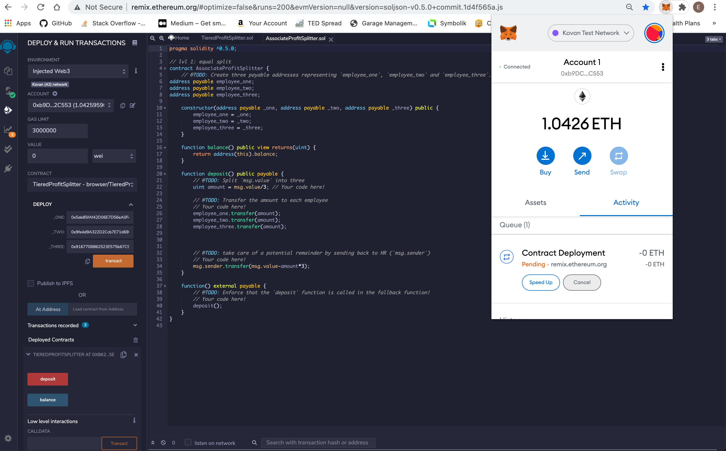
Deploy the the first contract in live Testnet

Slide 15
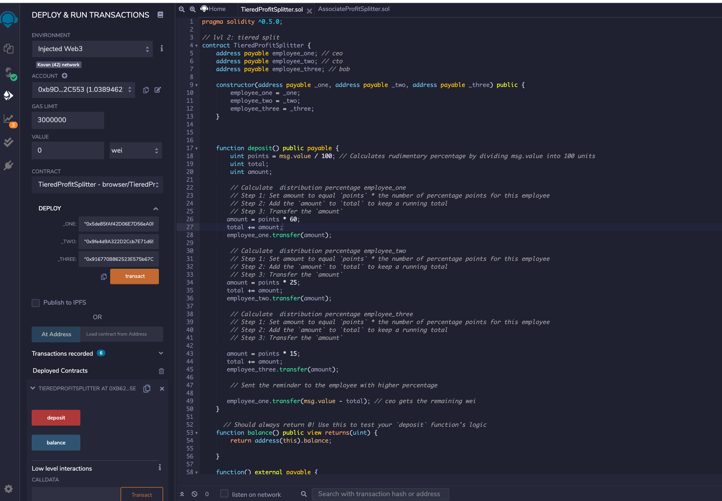
Deploy second contract in the live Testnet

Slide 16
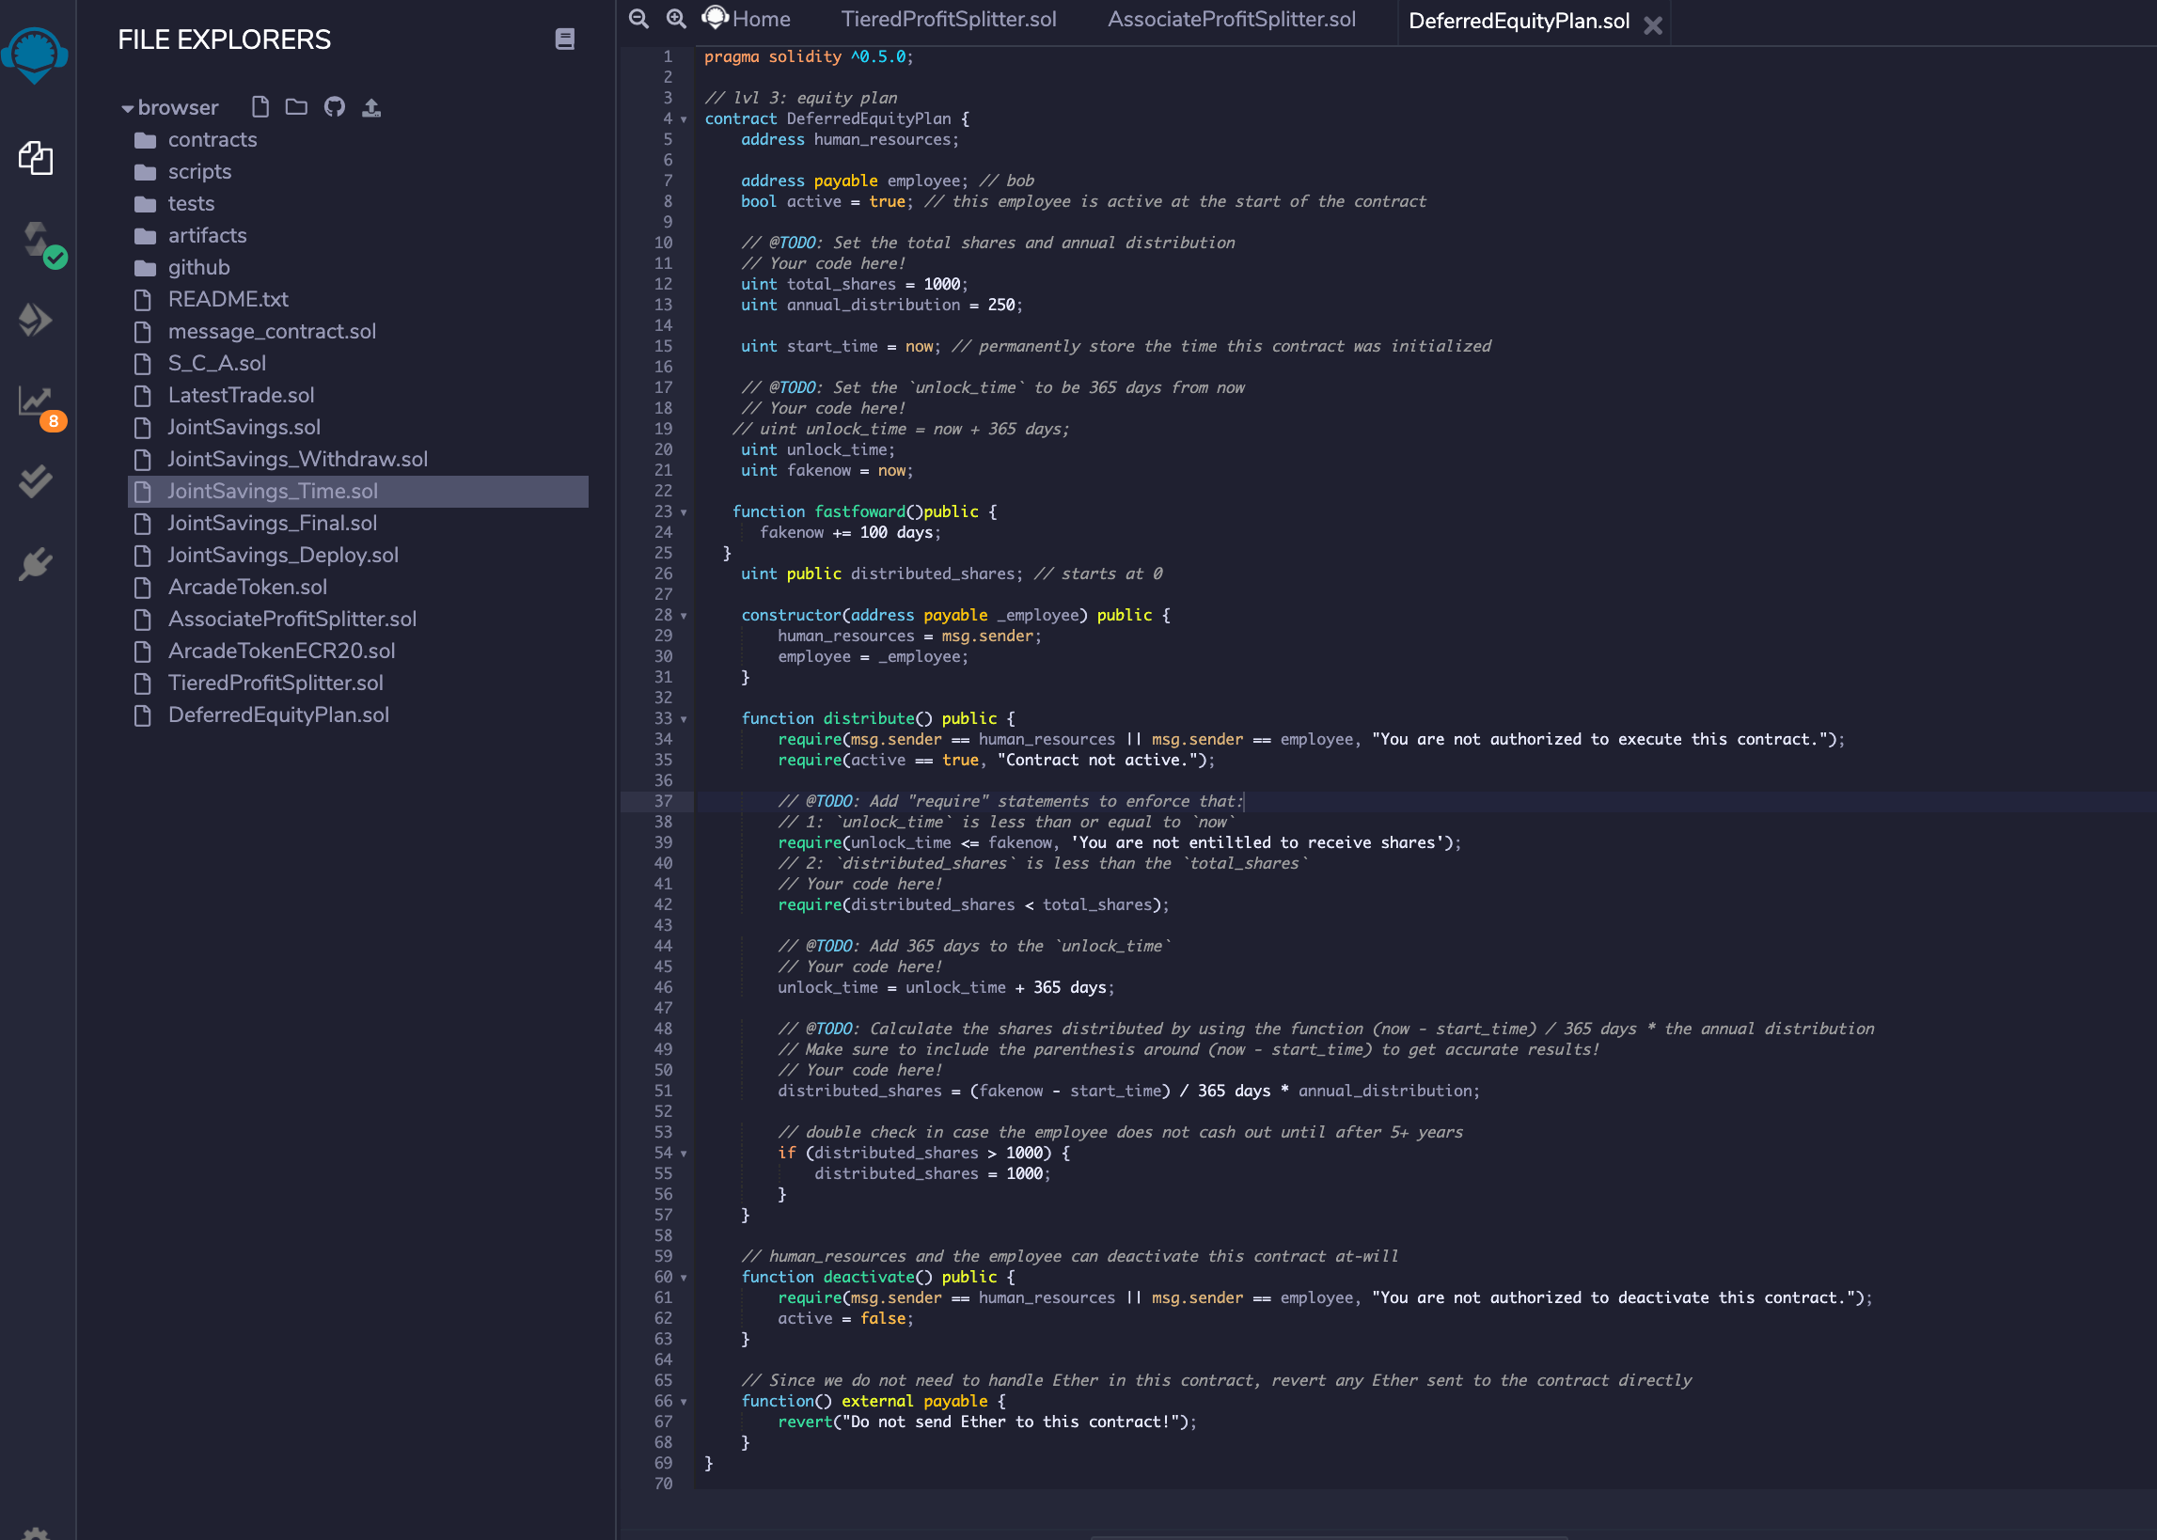
Create the third contract

Slide 17
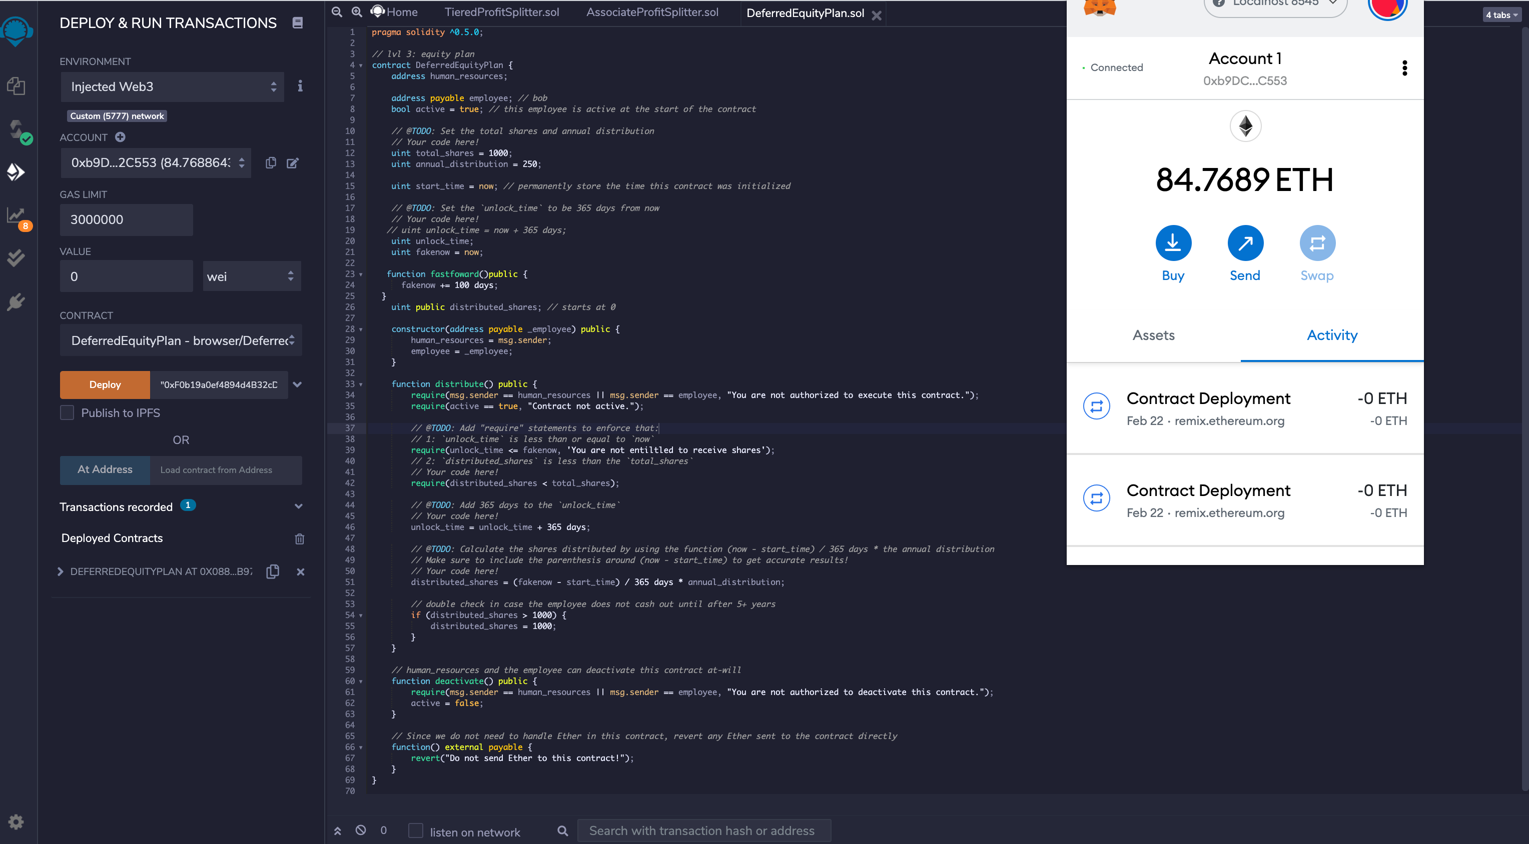
Compile the third contract

Slide 18
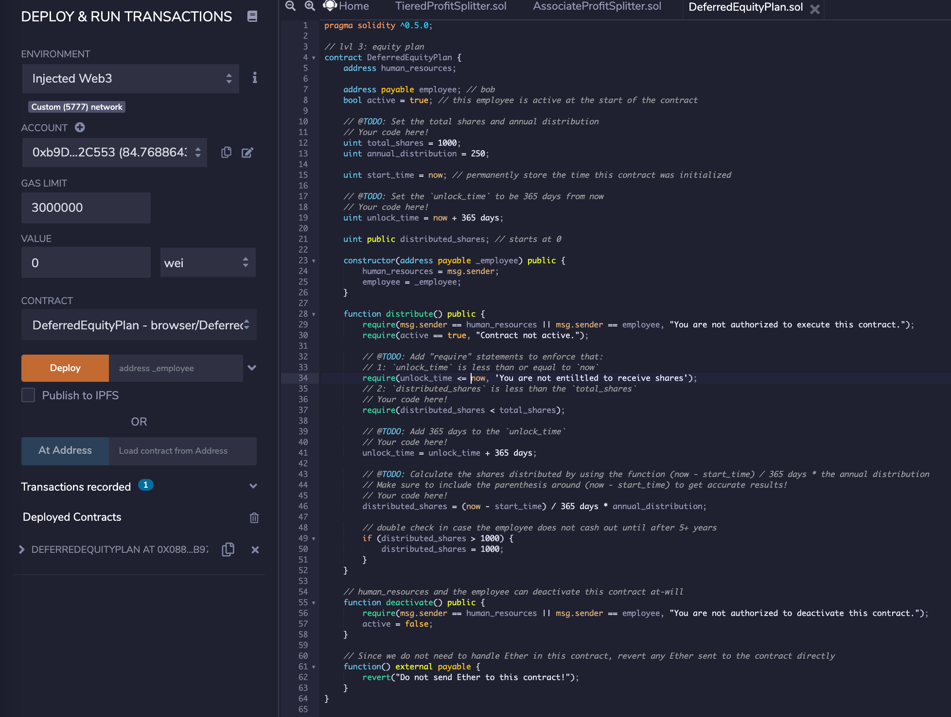
Deploy the third contract

Slide 19
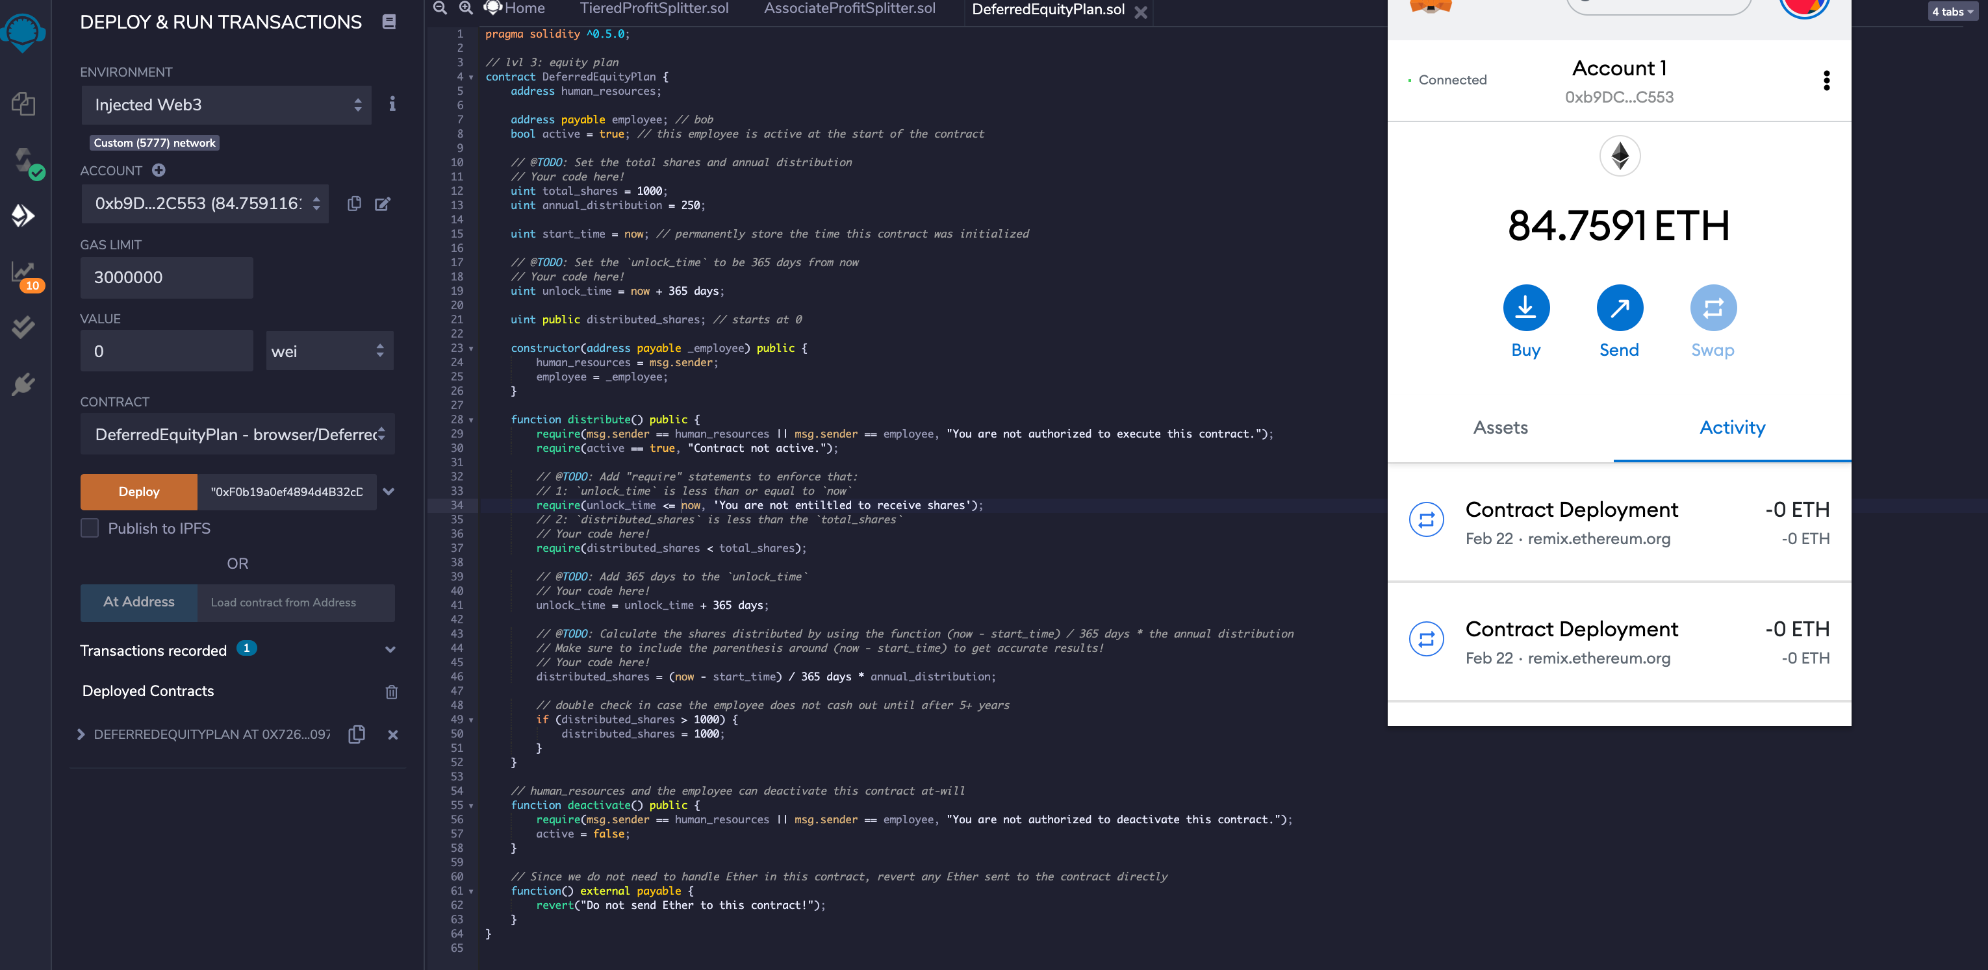
Test the third contract

Slide 20
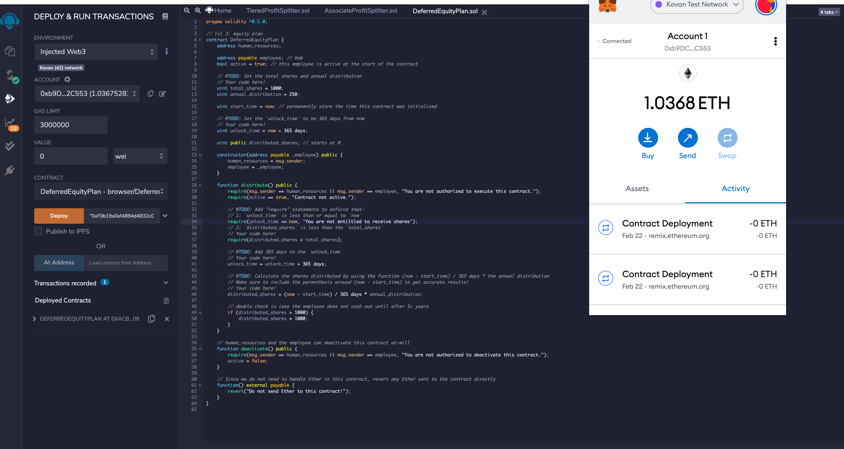
Deploy the Third Contract in live Tesnet

Slide 21
Copy the new addresses
0xB62DcFc3d9B5889cCbAf01d15a2EB81befF5EeE3
0xB62DcFc3d9B5889cCbAf01d15a2EB81befF5EeE3
0xACbbc4b7faC243eB95f1a12dFAd11E736E10613f

